Slide 1
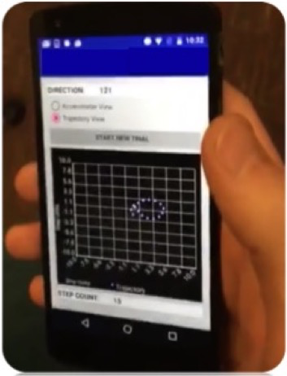
Unsupervised learning for
Indoor Localization and Floor Mapping
Max Maguire

Slide 2
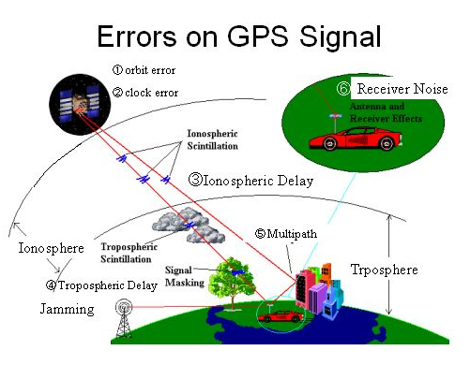
Motivation
GPS inaccessible settings
Line-Of-Sight
Power efficiency
Higher precision localization
Beam forming
VR/AR
Introduction
Experimental Set-Up
Data Flow Diagram
Algorithms
Discussion

Slide 3
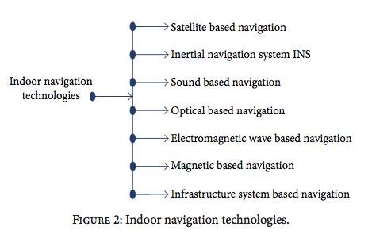
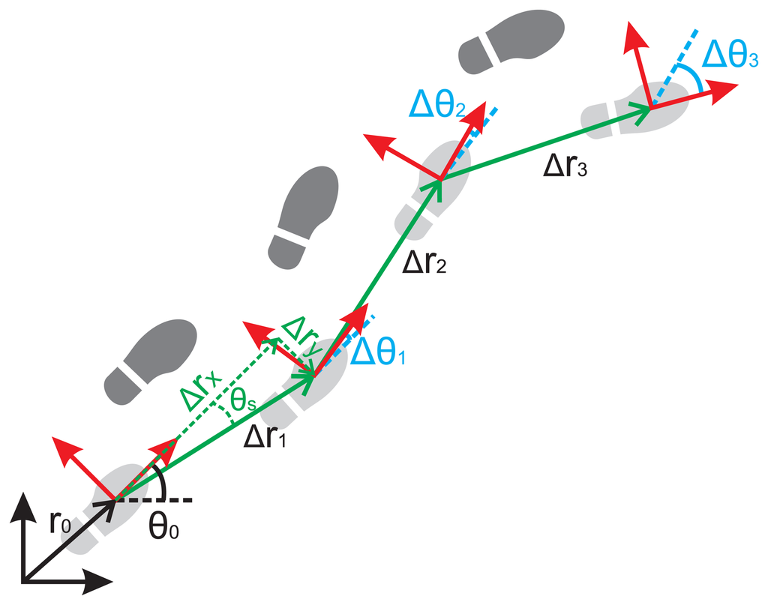
Context
Pedestrian Dead Reckoning
Transforms raw Data into state estimates using process model
Position
Orientation
* Zahid Farid, Rosdiadee Nordin, and Mahamod Ismail
“Recent Advances in Wireless Indoor Localization Techniques and Systems” 2013
Introduction
Experimental Set-Up
Data Flow Diagram
Algorithms
Discussion

Slide 4
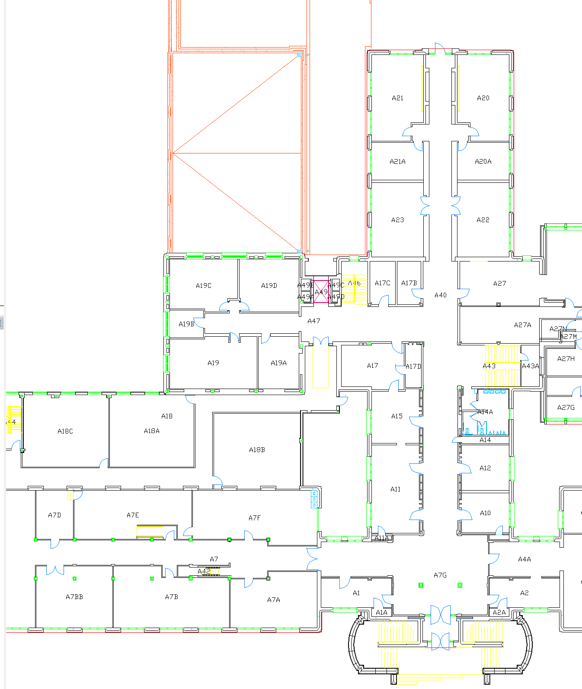
Experimental Set-Up
Raw Data:
- 3-axis Accelerometer, Gyroscope, Magnetometer
- 100 hz
Step Calibration:
- 9 recordings of set length/step count
Number of recordings:
- 17 trials
- 5 different paths
* https://www.cmu.edu/finance/property-space/floorplan-room/acad-admin/BPH/index.html
Introduction
Experimental Set-Up
Data Flow Diagram
Algorithms
Discussion
Notes:
Alpha shape

Slide 5
Data Flow Diagram
Raw Data
EKF
Step Detection
Trajectory Model
Segmentation
Classification
Floor Mapping
Introduction
Experimental Set-Up
Data Flow Diagram
Algorithms
Discussion

Slide 6

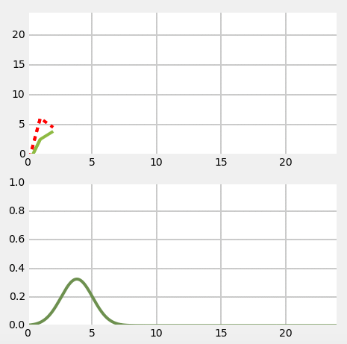
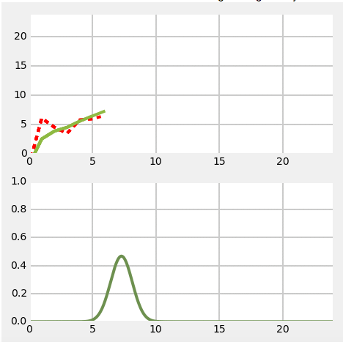
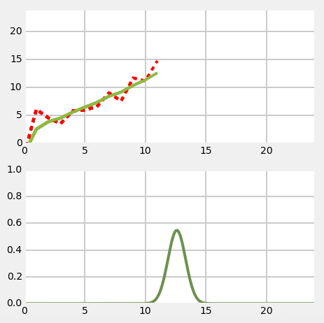
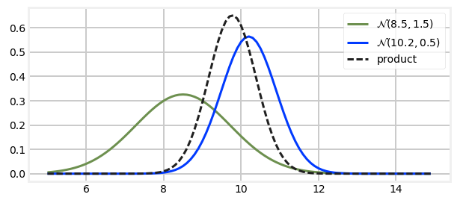
Extended Kalman Filter
Raw Data
Incorporates uncertainties into the process and observation models.
Corrects for potential sources inaccuracies using Bayesian inference and joint probability distributions.
EKF
Step Detection
Trajectory Model
Segmentation
Classification
Floor Mapping
Introduction
Experimental Set-Up
Data Flow Diagram
Algorithms
Discussion
Notes:
Implement EKF in order to estimate orientation of phone. The Extended Kalman filter is a version of the Kalman filter that works for non-linear problems. Instead of using a fixed matrix for the state and observations equations, we are computing the Jacobian matrix to linearize about an estimate of the current mean and covariance.
Inputs: accelerometer, gyroscope and magnetometer.
Sources of error: Drift, Noise, Bias
In addition to the in-line bias estimation of some of the sensors, we take into account the potential local disturbances of the magnetic field and the effects o f body motion
The relation between body coordinate vectors and global coordinate vectors are non-linear.

Slide 7
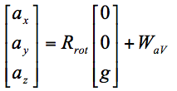
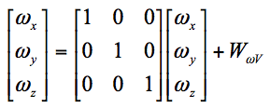
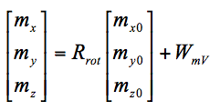
Extended Kalman Filter
Raw Data
EKF
Step Detection
Initialize Filter Design
Trajectory Model
Segmentation
Classification
Floor Mapping
Introduction
Experimental Set-Up
Data Flow Diagram
Algorithms
Discussion
Notes:
State Transformation model
Find the Dynamic System of the State
Discretize it via Taylors Expansion
- The measurement vector in our case is a discrete sampled signal from the devices. Therefore, we need to transform our model to a discrete time model.
Observation Transformation model
Find the Dynamic System of the State
Discretize it via Taylors Expansion
- The measurement vector in our case is a discrete sampled signal from the devices. Therefore, we need to transform our model to a discrete time model.
Rrot is the rotation matrix from the body coordinate to the global coordinate,

Slide 8
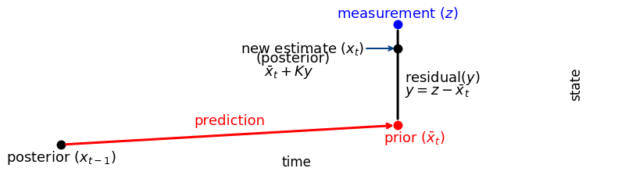
Extended Kalman Filter
Raw Data
EKF
Step Detection
Trajectory Model
Update
Segmentation
Classification
Floor Mapping
z
Predict
x
Introduction
Experimental Set-Up
Data Flow Diagram
Algorithms
Discussion
Notes:
PREDICT:
Predict next state
Project process uncertainty into state space
Map state estimate back into measurement space
UPDATE:
Find residual between observation and prediction
Calculate covariance of residual
Compute Kalman gain (weighted priority to prediction vs observation based on uncertainties)
Update state estimate using [Kalman gain]
Update state covariance using [Kalman gain]

Slide 9
Step Detection
Raw Data
EKF
Step Detection
Used to infer distance traveled
- Additional measure against cascading error from noisy measurements
Trajectory Model
Segmentation
Classification
Floor Mapping
Steps
Take Euclidean norm of 3-axis accelerometer data
Filter out high frequency noise
Apply Step Detection Threshold
Track range of signal peaks and valleys
Introduction
Experimental Set-Up
Data Flow Diagram
Algorithms
Discussion
Notes:
Method:
Used to infer distance traveled rather than integrating Accelerometer data.
- Designed to account for sudden orientation and attitude shifts of the phone during a walk.
- Additional measure against superposing error from noisy accelerometer data recordings
Take Euclidean norm of 3-axis accelerometer data
Smooth/filter out high frequency noise
Apply Step Detection Threshold
Record Valley and peaks
Solve for Step length coefficient
Smoothing: Moving average of 5 frames operated as a low pass filter (reducing strength of signals > 5hz)
Step Detection threshold: Established during calibration as 3*sigma

Slide 10
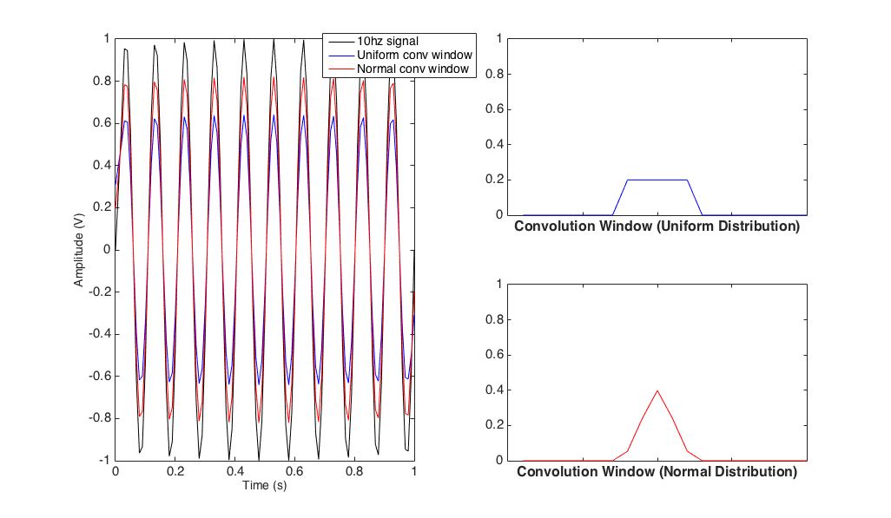
Step Detection
Raw Data
EKF
Step Detection
Steps
Trajectory Model
1. Accelerometer Magnitude:
Segmentation
2. Smoothing:
5 frame Convolution window
Classification
Results of Convolution based Smoothing
Floor Mapping
Convolution window (Uniform Dist.)
Convolution window (Normal Dist.)
Introduction
Experimental Set-Up
Data Flow Diagram
Algorithms
Discussion
Notes:
Method:
Used to infer distance traveled rather than integrating Accelerometer data.
- Designed to account for sudden orientation and attitude shifts of the phone during a walk.
- Additional measure against superposing error from noisy accelerometer data recordings
Take Euclidean norm of 3-axis accelerometer data
Smooth/filter out high frequency noise
Apply Step Detection Threshold
Record Valley and peaks
Solve for Step length coefficient
Smoothing: Moving average of 5 frames operated as a low pass filter (reducing strength of signals > 5hz)
Step Detection threshold: Established during calibration as 3*sigma

Slide 11
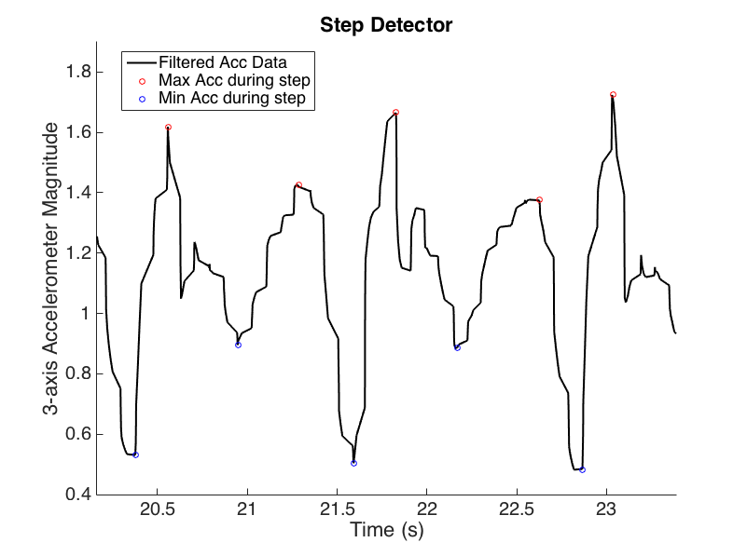
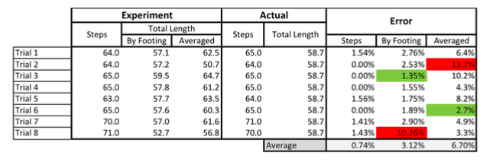
Step Detection
Raw Data
EKF
Step Detection
Steps
Trajectory Model
3. Filtering:
Step Detection threshold, Blanking window
Segmentation
4. Step Magnitude:
Classification
Step Detection Filter
Floor Mapping
Step Magnitude α Calibration
Introduction
Experimental Set-Up
Data Flow Diagram
Algorithms
Discussion
Notes:
Erroneous steps that were detected due to high frequency noise occurring at the threshold were discarded using a 0.3s blanking window following the onset of each step detected.
Smoothing: Moving average of 5 frames operated as a low pass filter (reducing strength of signals > 5hz)
Step Detection threshold: Established during calibration as 3*sigma

Slide 12
Trajectory Model
Raw Data
EKF
Step Detection
Trajectory Model
Step Detection
Segmentation
Classification
Floor Mapping
Y
Trajectory
Quaternion to Euler Angles
γ
Z
X
Introduction
Experimental Set-Up
Data Flow Diagram
Algorithms
Discussion
Notes:
Segment threshold (45 degrees)
Feature space:
length of the segment,
average time spent per step,
coordinates of the center of the segment

Slide 13
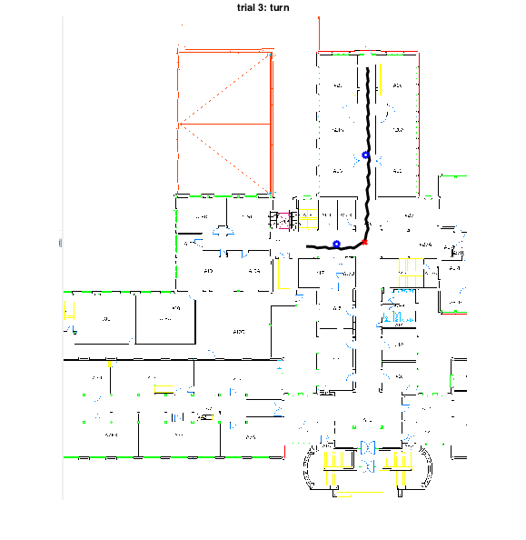
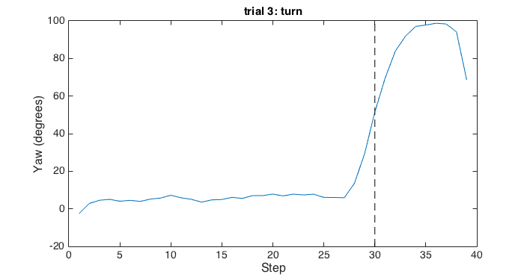
Segmentation
Raw Data
Decision Tree
EKF
Step Detection
Trajectory Model
Raw Trajectories
Example
Trial 3: Corridor turn
Segmentation
Heading Displacement
Classification
Floor Mapping
Segmented
Trajectories
Segment
Lengths
Room
Corridor
Introduction
Experimental Set-Up
Data Flow Diagram
Algorithms
Discussion
Notes:
Segment threshold (45 degrees)
Feature space:
length of the segment,
average time spent per step,
coordinates of the center of the segment

Slide 14
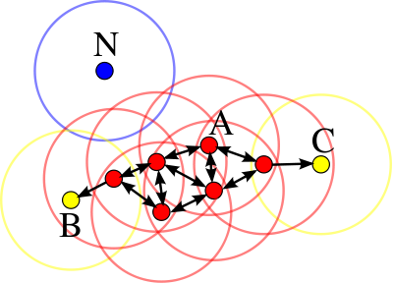
Classification
Raw Data
EKF
Step Detection
Trajectory Model
Segmentation
Classification
Floor Mapping
DBSCAN
(Density-Based spatial clustering algorithm with noise)
Pros
Unsupervised
Robust to noise
Cons
Sensitive to Tuning
- Find “k” neighbors of every point, and identify core points
- Find connected components of core points
- Assign non-core points to nearby clusters at at most distance ε, otherwise assign them to noise
Introduction
Experimental Set-Up
Data Flow Diagram
Algorithms
Discussion
Notes:
Feature space is composed of parameters:
Length
Center
Time spent
Clustering methods: DBSCAN vs Kmeans/KNN
Core point: = minPoints, epsilon

Slide 15
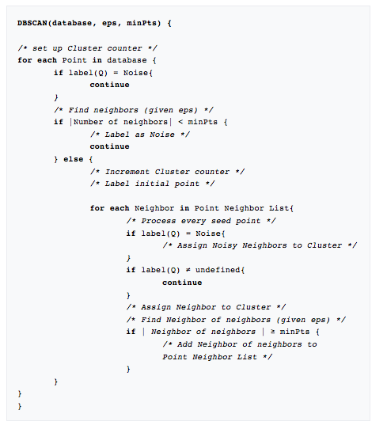
Classification
Raw Data
EKF
Step Detection
Trajectory Model
Segmentation
Classification
Floor Mapping
Introduction
Experimental Set-Up
Data Flow Diagram
Algorithms
Discussion
Notes:
Feature space is composed of parameters:
Length
Center
Time spent
Clustering methods: DBSCAN vs Kmeans/KNN
Core point: = minPoints, epsilon

Slide 16
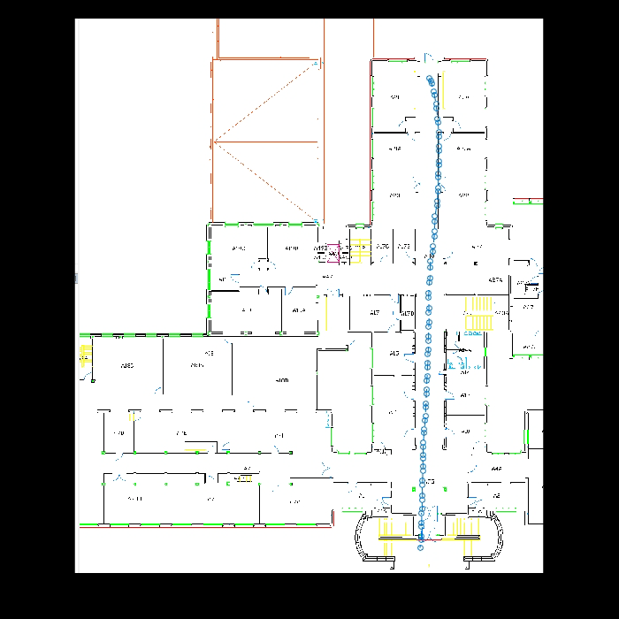
Floor Mapping
Raw Data
EKF
Step Detection
Trajectory Model
Segmentation
Classification
Floor Mapping
Draw a 2D alpha shape of the trajectory segments with alpha radius A.
Introduction
Experimental Set-Up
Data Flow Diagram
Algorithms
Discussion
Notes:
Alpha shape

Slide 17
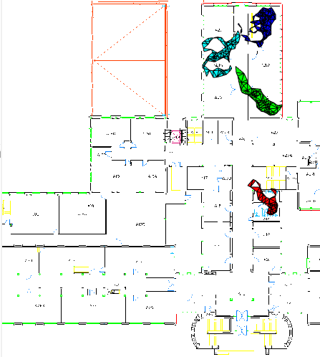
Discussion
Moving Forward…
Finding Anchor points
Anomalies from environment
Expanding Feature space
Gait Analysis
Additional Sensors
Scale application for larger database
Introduction
Experimental Set-Up
Data Flow Diagram
Algorithms
Discussion
Notes:
Alpha shape

